Slide 1
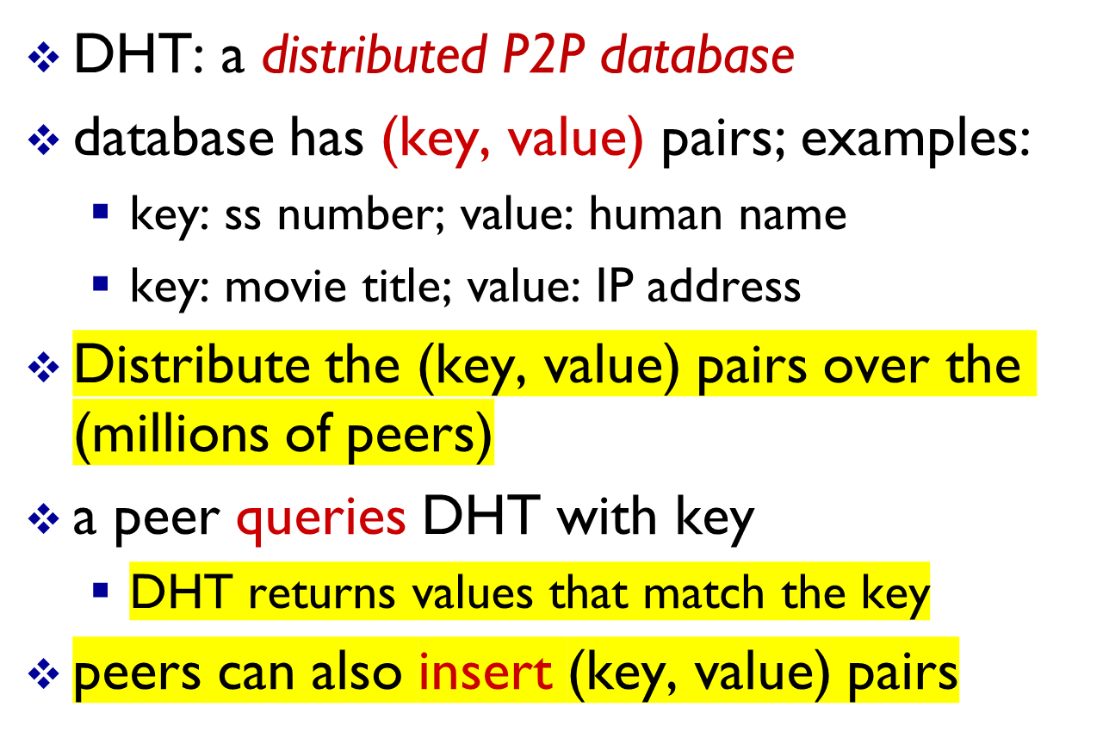
Distributed Hash Table (DHT)
Application 2-<number>

Slide 2
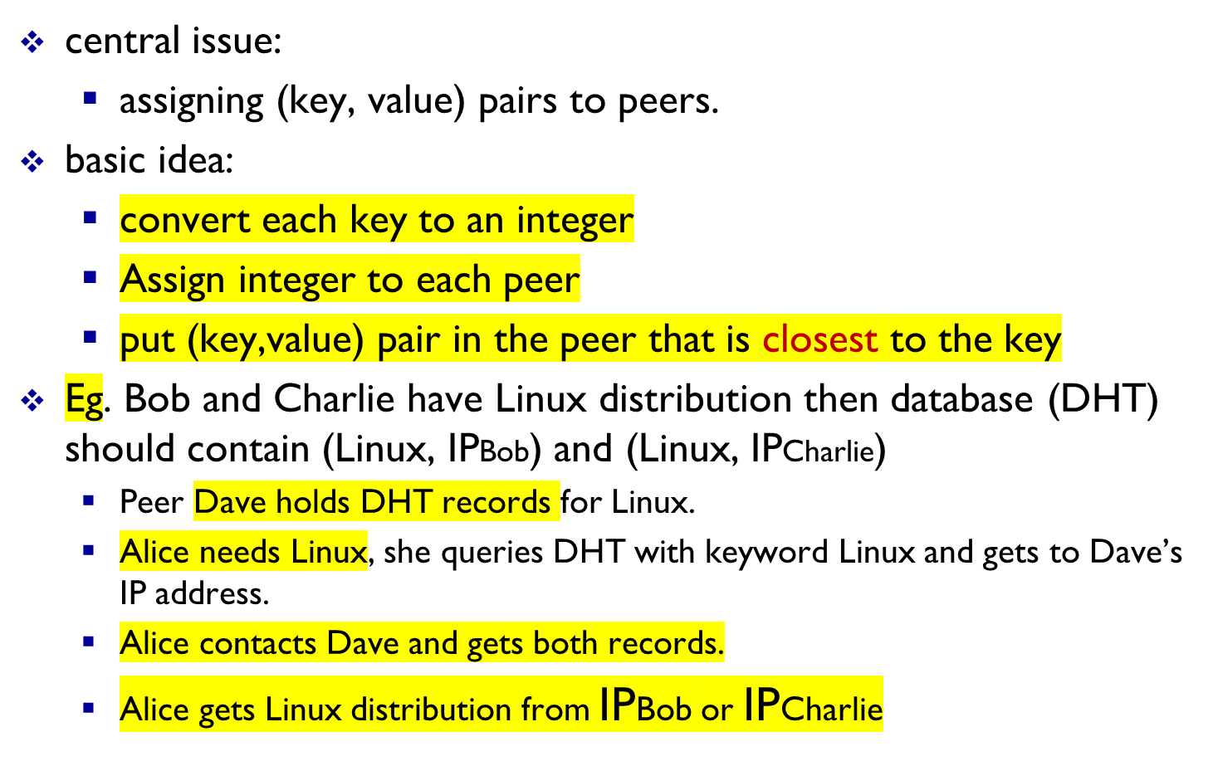
Q: how to assign keys to peers?
Application 2-<number>

Slide 3
DHT identifiers
assign integer identifier to each peer in range [0,2^{n}-1] for some n.
  each identifier represented by n bits.
require each key to be an integer in same range
to get integer key, hash original key
  e.g., key = hash(“Led Zeppelin IV”)
  this is why its is referred to as a distributed “hash” table
Application 2-<number>

Slide 4
Assign keys to peers
rule: assign key to the peer that has the closest ID.
convention in lecture: closest is the immediate successor of the key.
e.g., n=4; peers: 1,3,4,5,8,10,12,14;
  key = 13, then successor peer = 14
  key = 15, then successor peer = 1
Application 2-<number>

Slide 5
Circular DHT (1)
1
3
15
4
12
5
10
8
each peer only aware of immediate successor and predecessor.
“overlay network”
Application 2-<number>

Slide 6
Circular DHT (1)
O(N) messages
on average to resolve
query, when there
are N peers
0001
Who’s responsible
for key 1110 ?
I am
0011
1111
1110
1110
0100
1110
1100
1110
0101
1110
Define closest
as closest
successor
1110
1010
1000
Application 2-<number>

Slide 7
Circular DHT with shortcuts
1
Who’s responsible
for key 1110?
3
15
4
12
5
10
8
each peer keeps track of IP addresses of predecessor, successor, short cuts.
reduced from 6 to 2 messages.
possible to design shortcuts so O(log N) neighbors, O(log N) messages in query
Application 2-<number>

Slide 8
Peer churn
handling peer churn:
peers may come and go (churn)
each peer knows address of its two successors
each peer periodically pings its
two successors to check aliveness
if immediate successor leaves, choose next successor as new immediate successor
1
3
15
4
12
5
10
8
example: peer 5 abruptly leaves
peer 4 detects peer 5 departure; makes 8 its immediate successor; asks 8 who its immediate successor is; makes 8’s immediate successor its second successor.
Application 2-<number>

Slide 9
Peer churn – new peer joins
New peer with ID =13 wants to join the DHT.
It needs to know ID of one peer from the DHT say peer 1 (from tracker node).
Peer 13 will send request to peer 1 to find its predecessor and successor.
Peer 1 will forward this message through the DHT until it reaches peer 12.
Peer 12 sends its predecessor (10) and successor (15) IP addresses to peer 13.
Peer 13 makes peer 12 its predecessor and peer 15 its successor.
2: Application Layer

